Slide 1
Collecting and Using Cost Data in the Orange County System of Care
AEA – October 17, 2013
Brad R. Watts, Senior Research Scientist, Center for Human Services Research
Ann Cleary, Evaluation Coordinator, OC System of Care
Notes:
BW

Slide 2
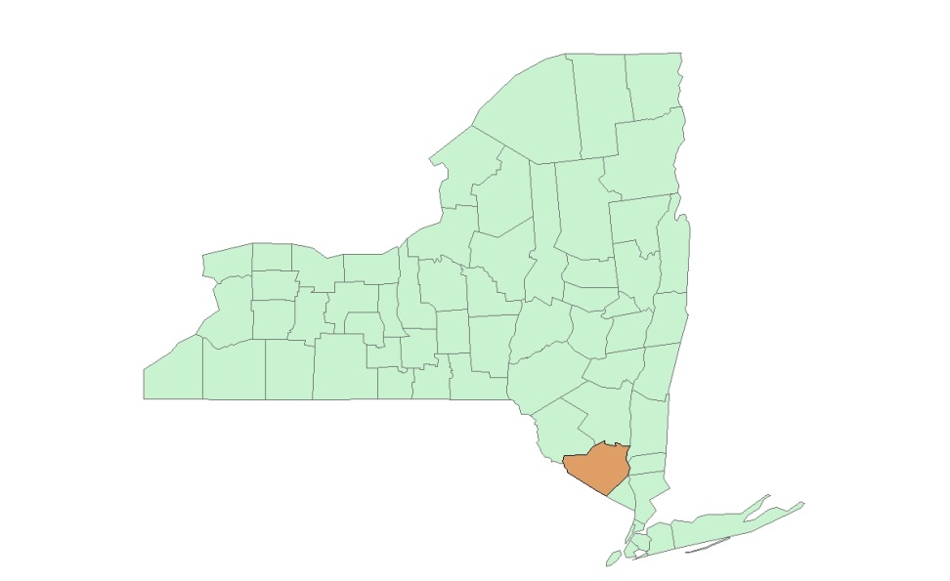
Overview
The System of Care approach is a new way of providing mental health services to children that has been adapted in Orange Co. New York .
What is System of Care?
A look at collecting costs from multiple sources in a loose-knit system
Challenges and lessons learned
What was done with the cost data?
Aggregate costs used by the Feds
What we can add and findings
Notes:
AC: System of Care: federal grant directed at systems change
Focuses on child serving agencies of youth with Serious Emotional Disturbance
Communities use grant dollars to
break down child-serving silos
adopt SOC Core Values & High Fidelity Wraparound
that has funded 243 communities since 1993*
Disbursed over 6 years

Slide 3
Required Evaluation Components
Descriptive Study (demographics, diagnostic info, and enrollment status)
Longitudinal Outcome Study (every 6 mos. for 2 years; measures improvement at home, in school, and in the community)
Services and Costs Study (tracks every service rec’d by every child enrolled into the Longitudinal Outcome Study, as well as who provided that service, who was charged how much, and who paid how much)
Notes:
AC

Slide 4
From Data Collection Perspective, Two Main Tasks
Identify Services Received
Collect Costs data from agencies providing the services
Usually two step process:
Program Staff provide type, dates, and units of service
Fiscal Staff provide associated costs and payer data
Notes:
AC

Slide 5
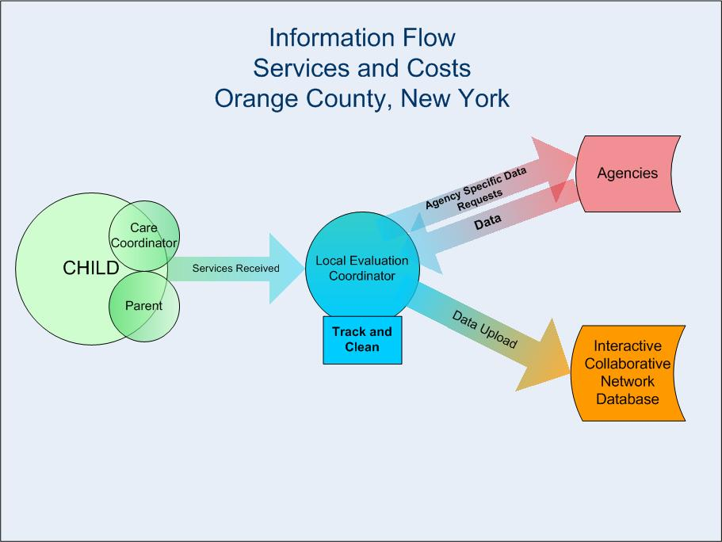
Notes:
AC: Flexibility in reporting formats to decrease burden
Tracking services during 2 year study period, independent of SOC enrollment, with rolling enrollment into study, so service events span from March 2010 through the end of March 2013.

Slide 6
Challenges
Heavy burden on agency staff
Differences between agencies in how spending and payment are tracked
Impossible to quantify what data is missing
Tension between what is useful locally and what is useful nationally
Notes:
AC: Differences in payment/ spending tracking b/n agencies:
Block grant funding
Medicaid and non-Medicaid ratios
“Retail” models
Unlike Longitudinal Study, which is a finite and described data set
Scale of picture painted
Nationally, aggregate data begins to tell a story about impact of grant funding
Locally level, sustainability and fiscal planning conversations happen with a much smaller brush. Conversations hinge on which agency will fund a particular position and how it will get paid for.
Payment sources look different locally. What may be grouped under MH dollars for the Ss & Cs study is understood locally to be a combination of state, county, and local dollars. Each funding stream comes with its own match and program use requirements.

Slide 7
Looking at Cost Data
SAMHSA looked at a lot...but their interests may be different:
“The primary purpose of the services and costs study is to describe the types of services received by children and youth and their families, their service use patterns, and the costs associated with these services.”
We looked at what could benefit OC, what has already been done, and what is still possible.
Notes:
Substance Abuse and Mental Health Services Administration
SAMHSA looks at what happened due to grant…locally perhaps more interesting is what has changed due to grant

Slide 8
Examples of Data from their Report What do they tell Orange Co? Important, but very general info.
Source: Comprehensive Community Mental Health Services for Children and Their Families Program. Services and Costs Study Data Report: Orange County System of Care. July 2013.

Slide 9
Macro vs. Micro
Two distinct audiences, both purse string holders:
The Feds
County level Department Heads
SAMHSA uses data to see what happened overall; locally Dept. Heads want to know how service provision has changed due to grant.
Federal scale: to fund or not?
Local scale: how to sustain? i.e., where are there savings and shifts? Opportunities for reinvestment?

Slide 10
Average Costs to Serve an Individual
Challenge: on-going program starts & exits; children may leave and return.
Solution: use individual enrollment/discharge dates and costs by service start date.
Average per Child in System of Care Study
400 days enrolled in SOC
$3,370 cost per month enrolled
Around $44,300 to serve average study participant
Notes:
Calculating simple stats can be difficult

Slide 11
Cost flows: Do costs vary over time in the SOC? Reason: look for “peaks” and at role of hard-cases.
Notes:
Shows the average cost per individual in the cost study for each three-month period following their initial intake.
Over time, the N declines because some kids leave and don’t use additional services. There are annual billing peaks, but general trend is upward.

Slide 12
Outcomes: Change divided by cost reveals average outcome per dollar expenditure in SOC.
Standardized outcome measure changes from baseline, on average, for every $10,000 spent on a child in the SOC.
Rank | Outcome Measure | Direction | SD Change
1 | # of delinquent behaviors, past 6 months | Decreases | 2.4
2 | Manifest anxiety scale (RCMAS-2) | Decreases | 1.5
3 | Emotional & behavioral scale (BERS-2Y) | Increases | 0.2
4 | Caregiver strain (CGSQ) | Decreases | 0.1
5 | Parental stress index (PSI) | Increases | 0.1
Standardized changes in outcome measures by a fixed dollar amount help to illustrate which conditions are comparatively easier to impact.
Notes:
The table shows the change that occurred on average for $10,000 spent on each child as measured in standard deviations of the group average score at intake.
Standardization provides a way to compare outcomes that are measured on different scales, provides way of comparing magnitude of changes that occurred.
Issue is the use of SD of initial test scores. Also, size of SD can be impacted by size of N.

Slide 13
Lessons learned
Access to data comes by way relationships—build them
Perspective determines which costs matter: Use national study design as a starting point; ask “What is useful locally?” before you begin collecting data
Plan for independent analysis
Consider how community looks at and uses existing costs data
Additional data fields (agency ID)
Notes:
AC: Relationships: part of the evaluator’s tried and true skill sets…too invaluable to not mention but not specific to this project. Won’t spend time today.
Practical: Work to eliminate imperfections; accept the unavoidable. (Perfect=the enemy of good.)
block funded agencies formula: Total program funding per year ÷ total case load per year ÷ 12 months to come up with a monthly per child cost.
Removes the durational aspect of services provided in the calculation of cost and does not parallel the data of a more retail model agency, such as a hospital..
Consult with analysts and community before starting
Feds and community are vastly different audiences. Eg., national report is light on what happens over the course of the initiative…this is the type of information that local advocates want to be able to show.
What costs data is currently discussed by the community and in what settings? This is how costs are likely to be discussed after grant funding is gone…can the national data fields be modified in such a way as to inform already occuring local conversations?

Slide 14
Lessons Learned
Determining cost-effectiveness requires knowing something about how the outcomes should be changing.
Standardization of outcomes is the way to go, BUT you need a good population to measure variance
Program-level vs. individual level cost trends can be very different.
Notes:
Big issue is lack of a comparison group – can’t determine cost-benefits, or whether these services are improving outcomes relative to standard care.
Within SOC, it does appear that some issues and outcomes change with less cost than others, but can’t determine how this compares.
Most important finding may be difference between total program cost trends and individual trends. While total costs generally declined over the two-years of SOC, the average costs of treating an individual increases. Cost savings come when clients exit; those that stay may be harder to treat.

Slide 15
Collecting and Using Cost Data in the Orange County System of Care
AEA – October 17, 2013
Brad R. Watts, Senior Research Scientist, Center for Human Services Research
Ann Cleary, Evaluation Coordinator, Orange County NY System of Care

